Slide 1


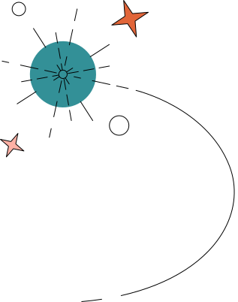
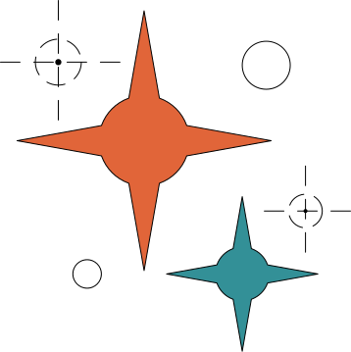





DEVELOPING A SHELL OR COMMAND LINE INTERFACE

Slide 2



Course Code : CSE 324
Course Title : Operating Systems Lab
Nushrat Jahan Oyshi
Lecturer
Department of CSE
Daffodil International University

Slide 3

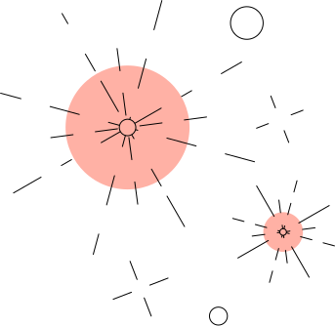

TEAM INFO
Shahriar Imtiaz Limon
0242310005101283
Mosabbir Hossen Maruf
0242310005101182
Md. Tamim Islam
0242310005101285
Md. Mahidul Islam
0242310005101289
Ibrahim Walid Khan
0242310005101242

Slide 4





TABLE OF CONTENT
Introduction
Objective
Methodology
Project Timeline
Flowchart & Tools
Team member and responsibilites
Expected Project Outcomes
Benefits
Future Plan
Reference
Conclusion

Slide 5



INTRODUCTION
A Shell, or Command Line Interface (CLI), is a program that allows users to interact with the operating system using text commands. Examples of popular shells include Bash, PowerShell, and Zsh. The CLI is crucial for tasks such as automation, scripting, and system administration. Its importance lies in providing a lightweight, efficient, and flexible way for users to control and manage a system.

Slide 6

OBJECTIVE
  To design and develop a basic shell that can interpret and execute commands.
  To provide custom features such as command history, simple scripting, and piping.
  To help users understand how shells process user input and manage system processes.

Slide 7


METHODOLOGY
Analyze requirements to identify core features.
Design the shell architecture.
Implement using Python.
Parse and execute commands.
Test with sample commands and scripts.
Debug and improve based on results.

Slide 8


PROJECT TIMELINE
  Start with basic research and understanding what the shell needs to do.
  Then design how the shell will work and plan its structure.
  After that, build the main features like command parsing and running commands.
  Add extra features such as command history and piping.
  Finally, test everything, fix issues, and prepare the documentation and presentation.

Slide 9
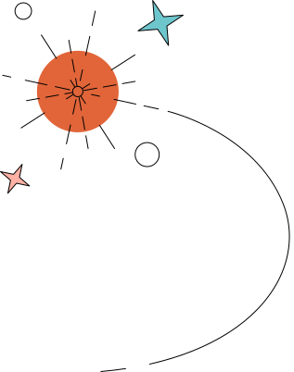
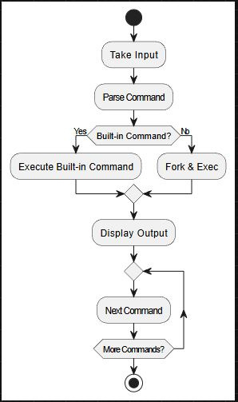




FLOWCHART & TOOLS
Programming Language: Python
Operating System: Linux
GUI / Frontend : Tkinter

Slide 10
TEAM MEMBERS AND RESPONSIBILITES
  Shahriar Imtiaz Limon - System Design and Research
  Mosabbir Hossen Maruf - Frontend, Project Report
  Md. Tamim Islam - Backend, Project Report
  Md. Mahidul Islam - Backend, Project Report
  Ibrahim Walid Khan - Backend, Project Report

Slide 11
  A functional command line interface capable of executing basic operating system commands.
EXPECTED PROJECT OUTCOMES
  Improved understanding of process management, input/output handling, and scripting.
  Inclusion of custom features such as command history, command chaining, and error reporting.

Slide 12
  Enhances programming and debugging skills.
  Improves knowledge of process management and input/output handling.
BENEFITS
  Better understanding of OS internals.

Slide 13
  Improve error handling with detailed messages and debugging tools.
  Optimize performance for faster command execution and parsing.
FUTURE PLAN
  Expand compatibility across Linux, macOS, and Windows and Add user-friendly features like auto-completion, history, and theming.

Slide 14
REFERENCE
https://www.geeksforgeeks.org/linux-unix/how-to-create-a-shell-script-in-linux/
https://medium.com/@santiagobedoa/coding-a-shell-using-c-1ea939f10e7e
https://stackoverflow.com/questions/4772847/creating-a-cli-shell-in-python

Slide 15

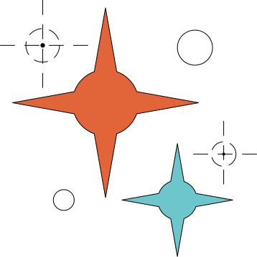
CONCLUSION
Developing a shell demonstrates the fundamental principles of operating systems and user interaction. The project strengthens programming, problem-solving, and system-level understanding. A basic shell serves as a stepping stone toward more advanced system software or automation tools.

Slide 16

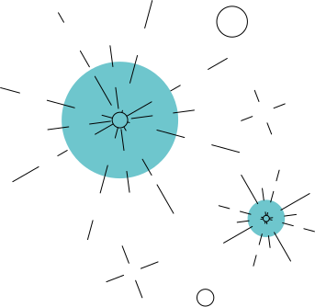

Any question??

Slide 17
THANK YOU

